Slide 1
Exploring Conversations as a Platform
Brijraj Singh
Sr. Software Engineer (CSE)
Microsoft
@brijrajsingh
Brijraj.singh@Microsoft.com
Munish Malhotra
Sr. Software Engineer (CSE)
Microsoft
Munish.malhotra@Microsoft.com
Notes:
Put your details above.
Each slide contains example script in the notes. Once confident with the content, you can use the headings in the notes as cues to ad-lib the content in your own words.

Slide 2
How did we get here?

Slide 3
Command Line
C:\
Extremely powerful
Tell me what to do
Cut right to what you're looking for…
using a language you don’t know
... if you know the right commands
P.S. I will delete all your files if you get even the tiniest detail wrong.

Slide 4
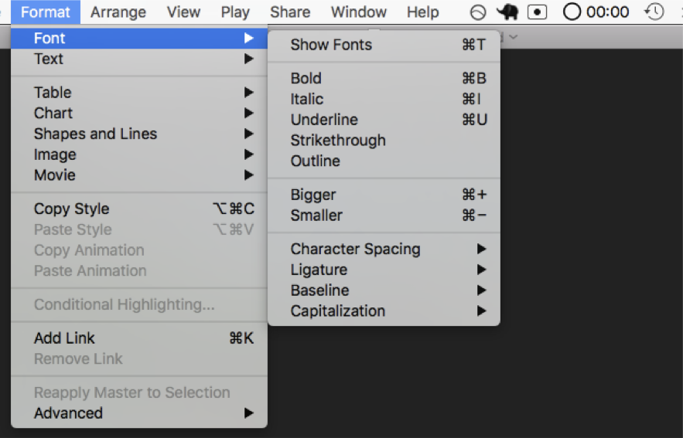
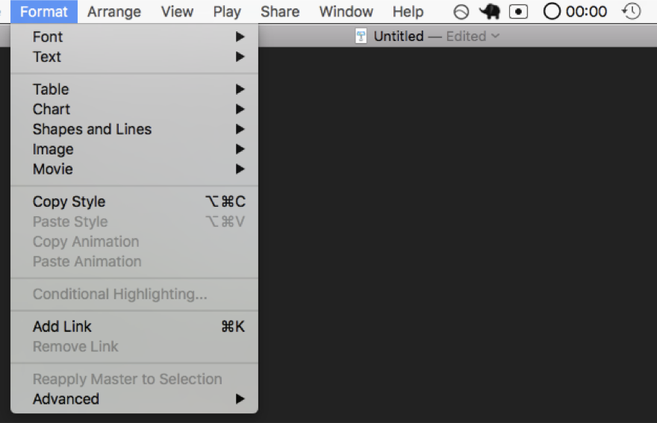
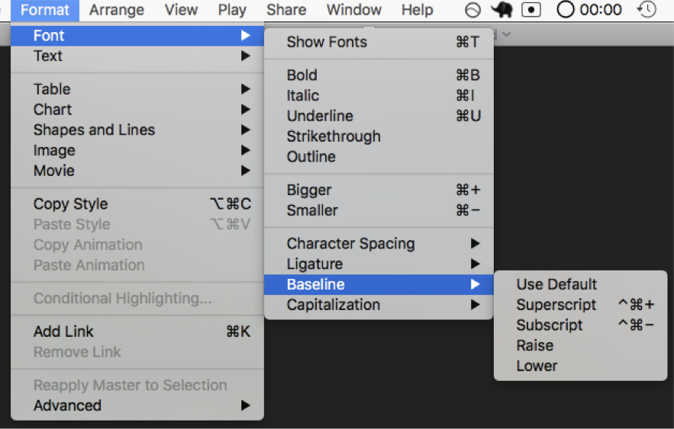
Menus
Nice for novices
Select from the following options
Everything is right there, out in the open…
So many options
… if you can find it
Yo, I heard you liked options so here are some options for your options

Slide 5
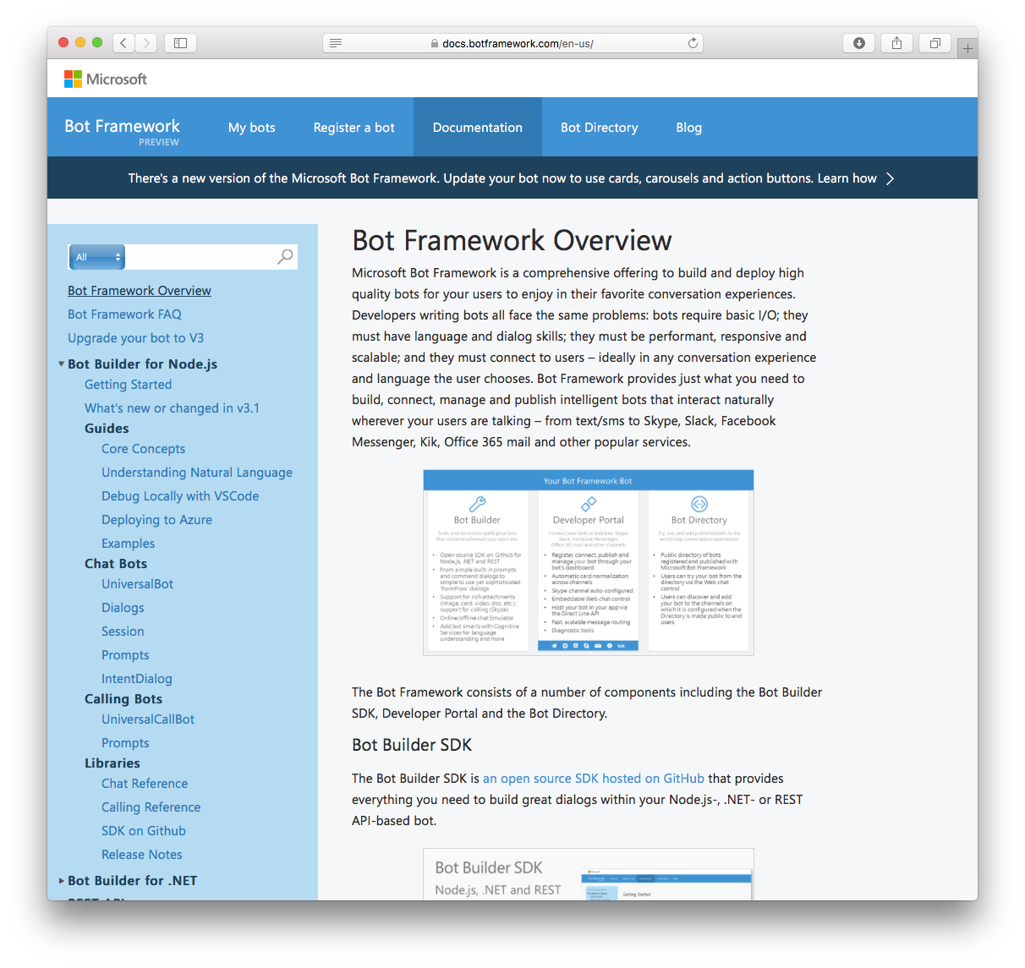
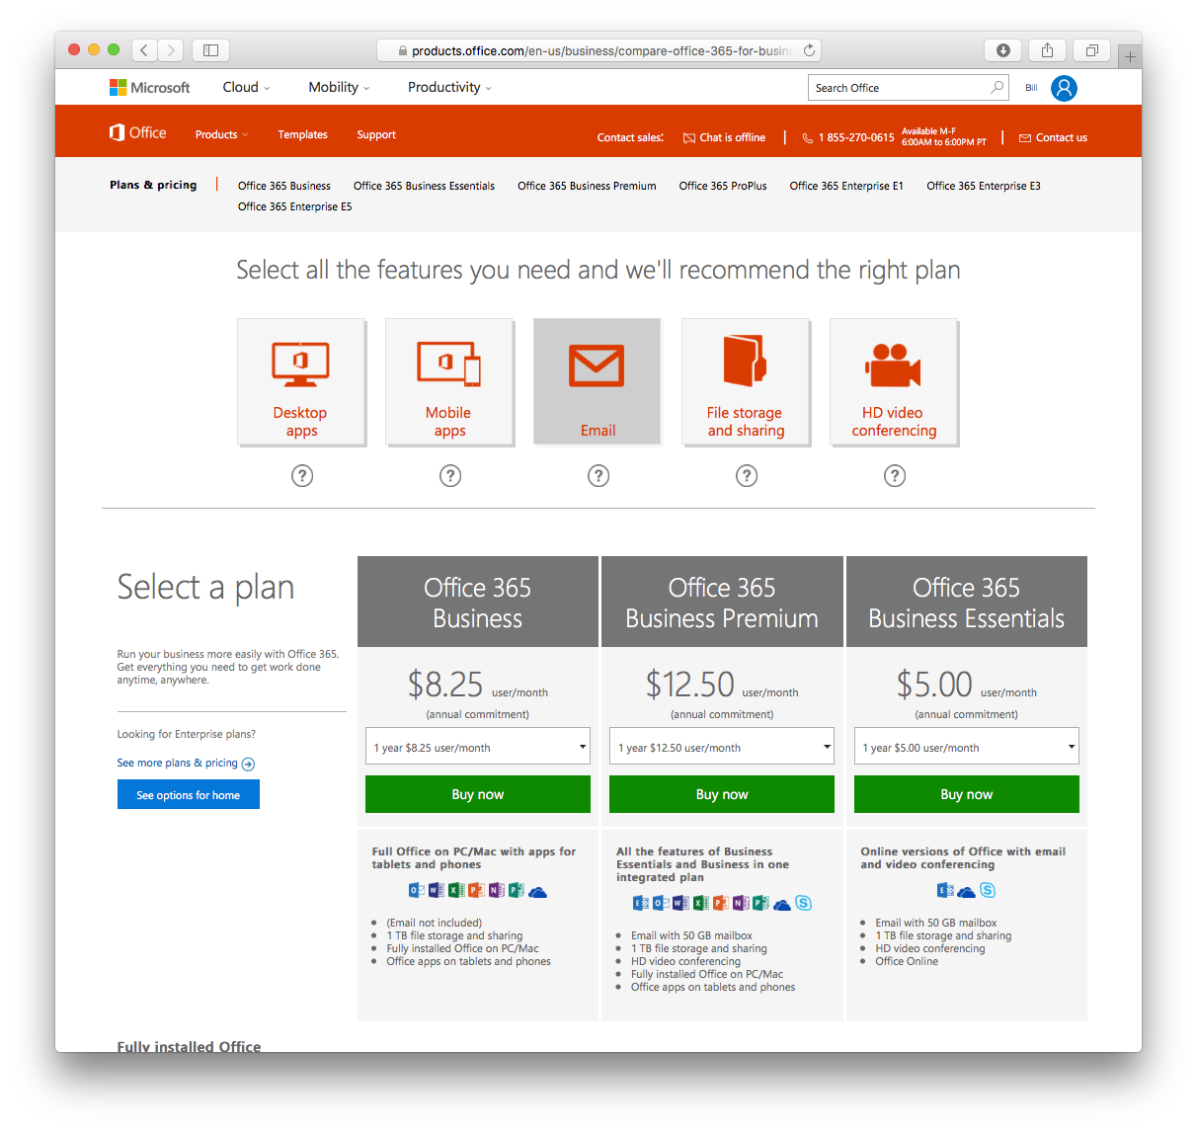
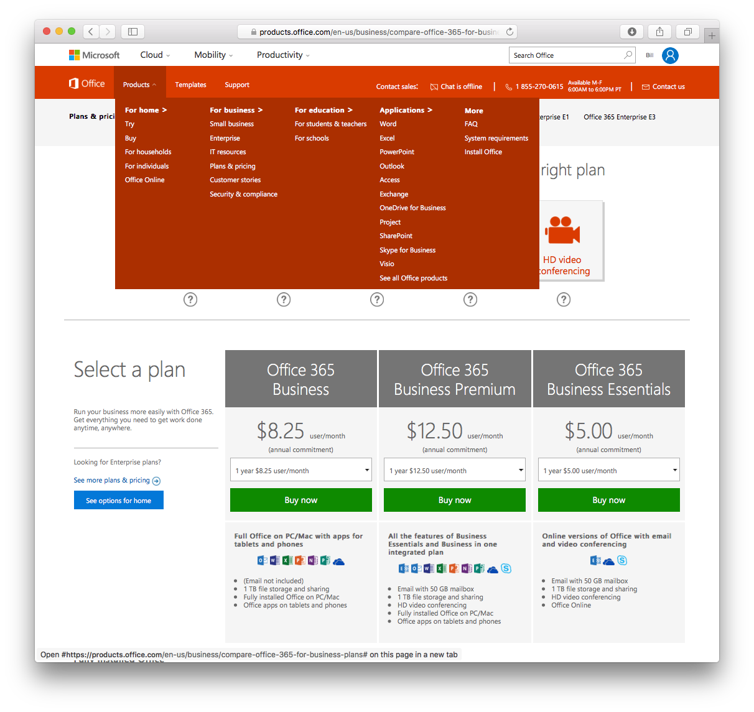
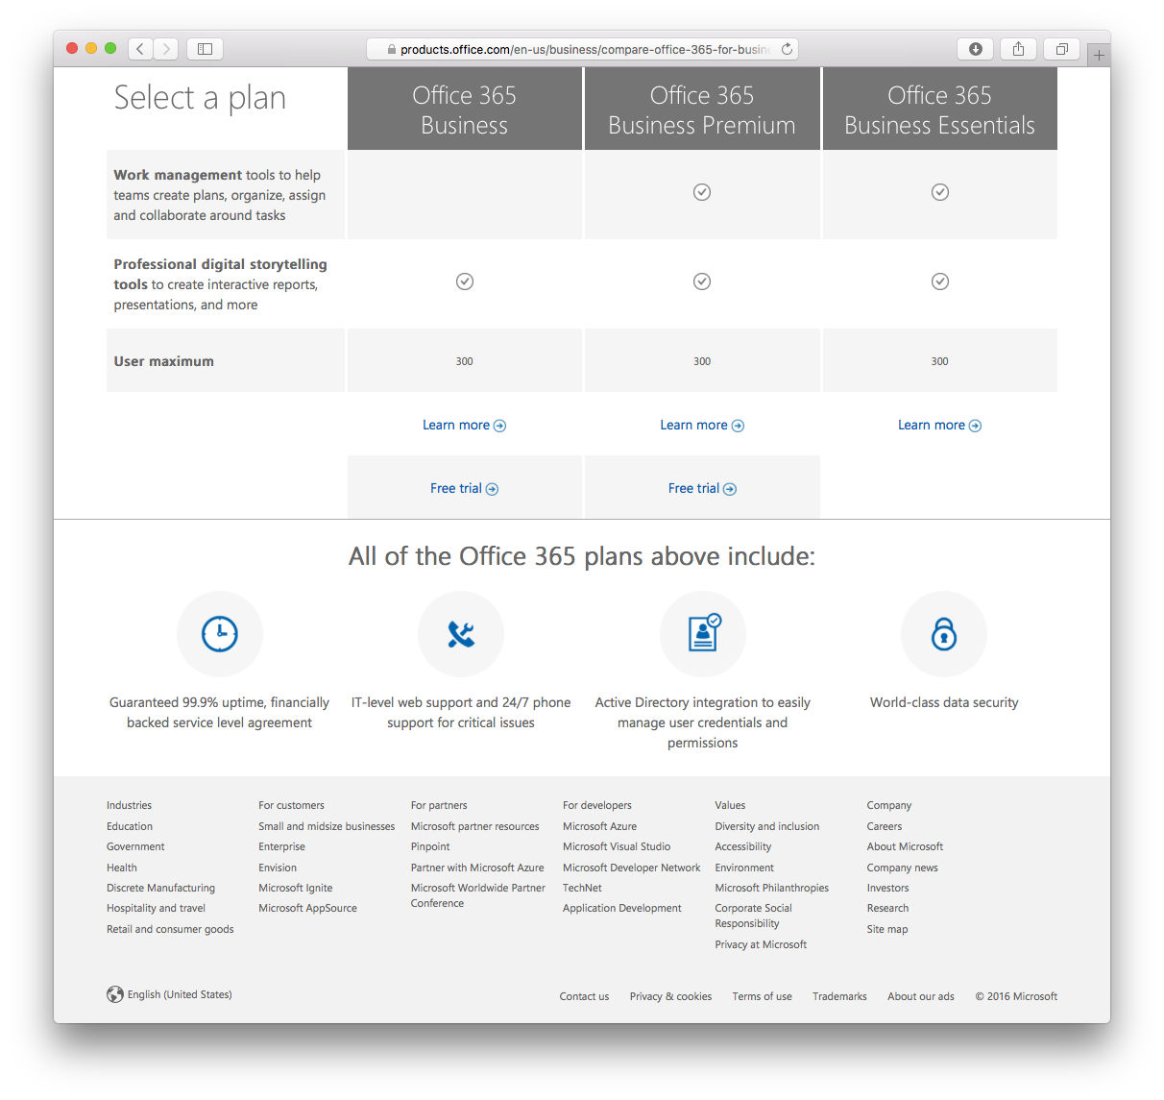
Websites
Good luck finding what you’re looking for.
Keep looking, it’s there somewhere.
Probably.
Start over again with the next website.

Slide 6
So why now?

Slide 7


Slide 8
IT’S YOUR JOB TO FIGURE OUT THE COMPUTER
LET’S MAKE
THE COMPUTER FIGURE OUT YOU
THE COMPUTER

Slide 9
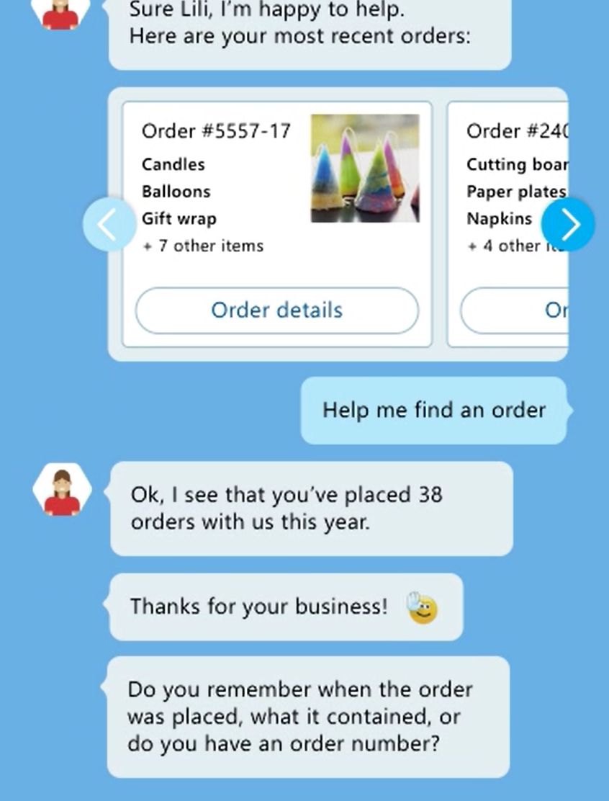
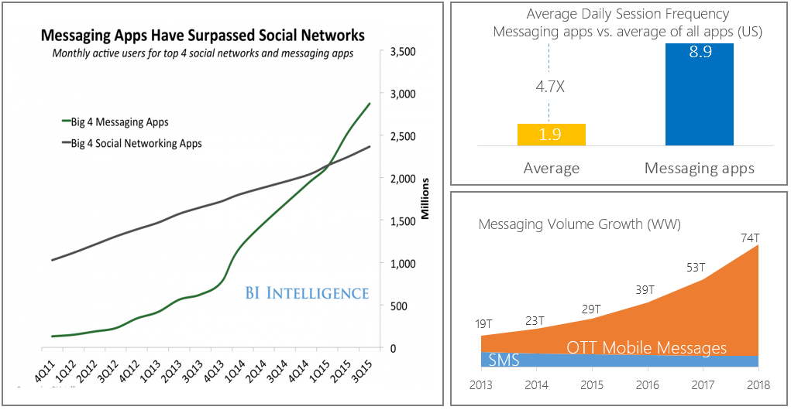
Messaging is King
Monthly active users of the top 4 messaging apps surpassed monthly active social network app users in Q1 2015
Source: BI Intelligence, Portico Research
Notes:
This chart from BI Intelligence, Portico Research, shows the number of social networking users and the number of messaging app users from the big 4 apps from the respective categories.
First, let’s note the scale on the right. We are talking 2.5 to 3 Billion users.
Note the timeline on the bottom with quarters and years.
You can see that in Q1 2015, the number of users on the top 4 messaging apps started to exceed the number of users on the top 4 social networking apps, and that continued upward into Q2 and Q3.
Now those messaging apps may be related to the social sites, but it’s clear that messaging is king.
Messaging is where the users are.

Slide 10
What is a bot?
Notes:
Given all that, what is a bot?

Slide 11
A bot is an app

Slide 12
Similar design, different paradigm
Traditional Application
Bot
Main Screen
Root Dialog
New Order Screen
Product Search Screen
New Order Dialog
Product Search Dialog

Slide 13
Bot or not?
Bots:
Don’t just search with query results
Act as agent for user
Translate user intent
Perform actions
Combine data from multiple sources
Maintain dialog context
May exhibit personality
Notes:
If bots are so popular should we use a bot for everything?
Well, first of all, bots are not the right substitute for straight search queries
CLICK – Not basic search
Bots aren’t intended to provide straight search results. Your search engine or tool is still the right way to go for that.
CLICK – Act as agent
Bots get information on behalf of the user and present it back to the user in a palatable way.
CLICK – Translate user intent
While a search engine accepts queries and provides results, a bot figures out (perhaps through a series of interaction with the user) what the user wants to do or know (doesn’t just do a look up)
CLICK – Combine data from multiple sources
As your agent, the bot may go off to different back-end systems to get the result it needs and combine the results. It may also action things across multiple systems
CLICK – Maintain dialog context
Unlike users of a search engine which is largely stateless, a user interacts with a bot which may build up conversation-specific, cross-conversation, and conversation –depth-based state.
CLICK – May exhibit personality
As the bot works as an agent, the style (and perhaps timing) of the way it presents things may be perceived as a certain personality. This may help welcome or endear users to use of the bot.

Slide 14
Demo
Skyscanner – Skype Bot
Notes:
Demo 1.1
Let’s take a look at a bot in action, connected to Skype

Slide 15
Messaging Forecasts in Business
65% of smartphone owners already use voice assistants on their phone
By 2018, at least 50% of the newest versions of enterprise software products will include some CaaP-based capabilities
80% of executives believe artificial intelligence improves worker performance and creates jobs
By 2020, at least 80% of new enterprise application releases will make reasonably strong use of chatbots
Source: BI Intelligence, Portico Research
Notes:
So we know that people are using messaging apps a lot, and more so than social networking apps now.
This is far from being just a consumer-only situation.
CLICK
READ stat
With so many people having assistant-enabled smart phones, it’s clear that bot use spans consumers and business. In fact, a large part of what bot assistants do on smartphones, is help people with their work appointments.
CLICK
READ stat
So there’s a large amount of support at the CxO level.
CLICK
READ stat
Businesses are explicitly taking on CaaP
CLICK
READ stat
This is pretty quick adoption in the very near future

Slide 16
Potential Benefits
Engage with the chat-generation
Lowered business cost to serve internally and externally
Improved resource focus on other tasks
More quickly connect users with information and services
Act as a friendly navigator for legacy or cumbersome data
Notes:
CLICK – Engage with generation
The ‘chat-generation’ is significant and using bots means you are better placed to engage those users
CLICK – Lowering cost
If done well, the user of bots can lower costs for the enterprise and for serving customers
CLICK – Free up resources
This doesn’t mean that bots are replacing jobs. The resources who may have handled queries and routine actions are now free to focus on other more sophisticated and critical tasks. Perhaps level 1 support becomes a bot, and more people are freed up to work on level 2 support.
CLICK – Connect users
A bot may help a user bypass a minefield of information and perform actions directly.
CLICK – Data navigator
Building a context in depth through interaction with a bot, will likely be better than a general website search or filling in a generic form.

Slide 17
Industry Momentum
8
800M
monthly active WeChat users, 200M with credit cards linked to their accounts
67,000
developers on Microsoft’s Bot Framework
55,000
15,000
bot developers on Facebook*
skills in the Amazon Alexa store
Notes:
So how well is the software industry doing with bot use and development?
CLICK – 800M WeChat
There are 800 million active WeChat users each month. A quarter of those have a credit card linked to their account ready to use.
CLICK – 67,000 Bot Framework users
The Microsoft Bot Framework has had 67,000 developers using it. That’s a lot of interest.
CLICK – 55,000 bot developers on Facebook
And…. 55,000 developers doing bot work on Facebook
CLICK – 15,000 skills in Amazon Alexa store
15,000 skills have been built for the Amazon Alexa store

Slide 18
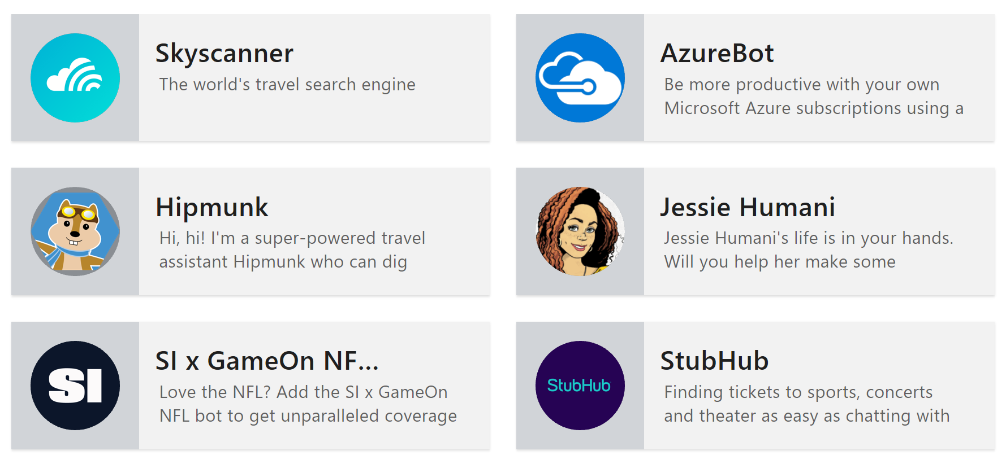

Real bots
Notes:
There are real bots being built to do real things.
Here are just a handful.
CLICK – Expedia
Expedia, a major player in travel is using a bot through skype to allow users to make hotel bookings directly or manage existing hotel and flight bookings. The bot can hand-off to a human operator for complex tasks.

Slide 19
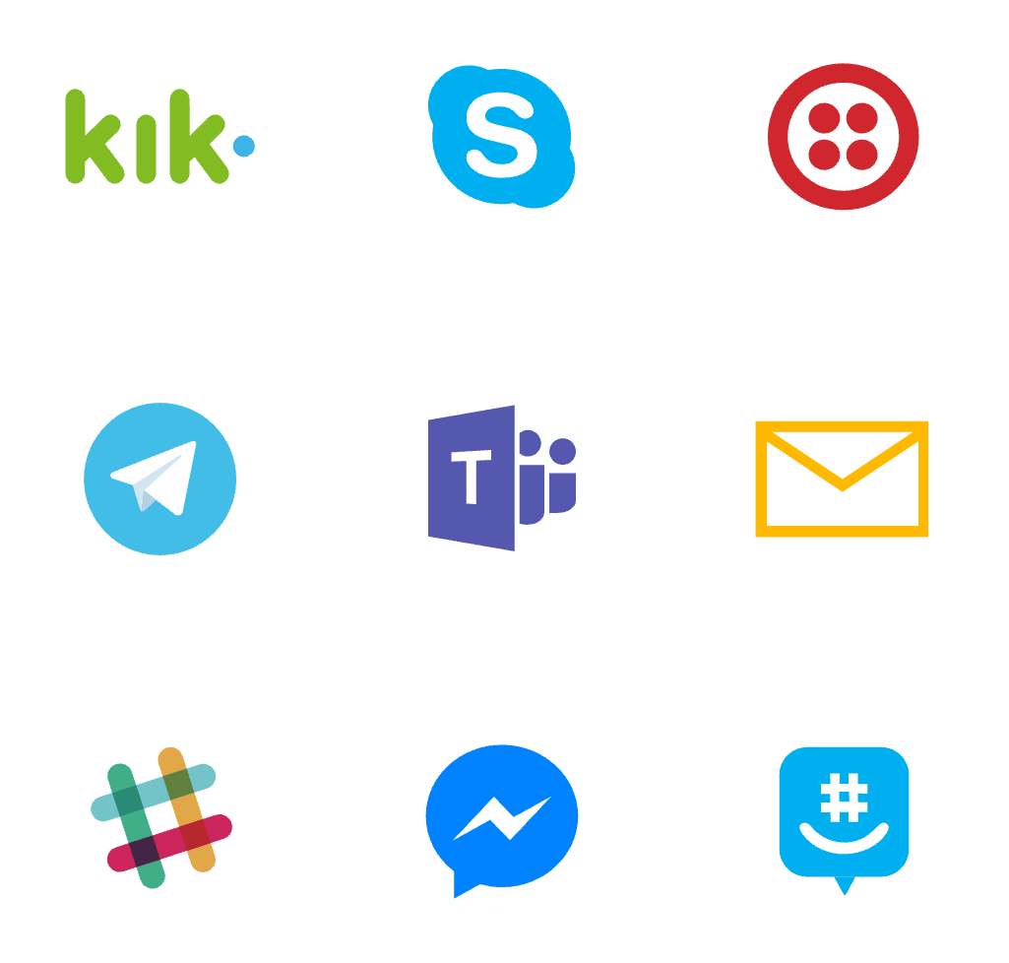
Where bots live
Notes:
We’ve seen bots in Skype, but they are available in many different channels used by both consumers and business users.
It’s very easier to have a bot appear in these different channels.

Slide 20
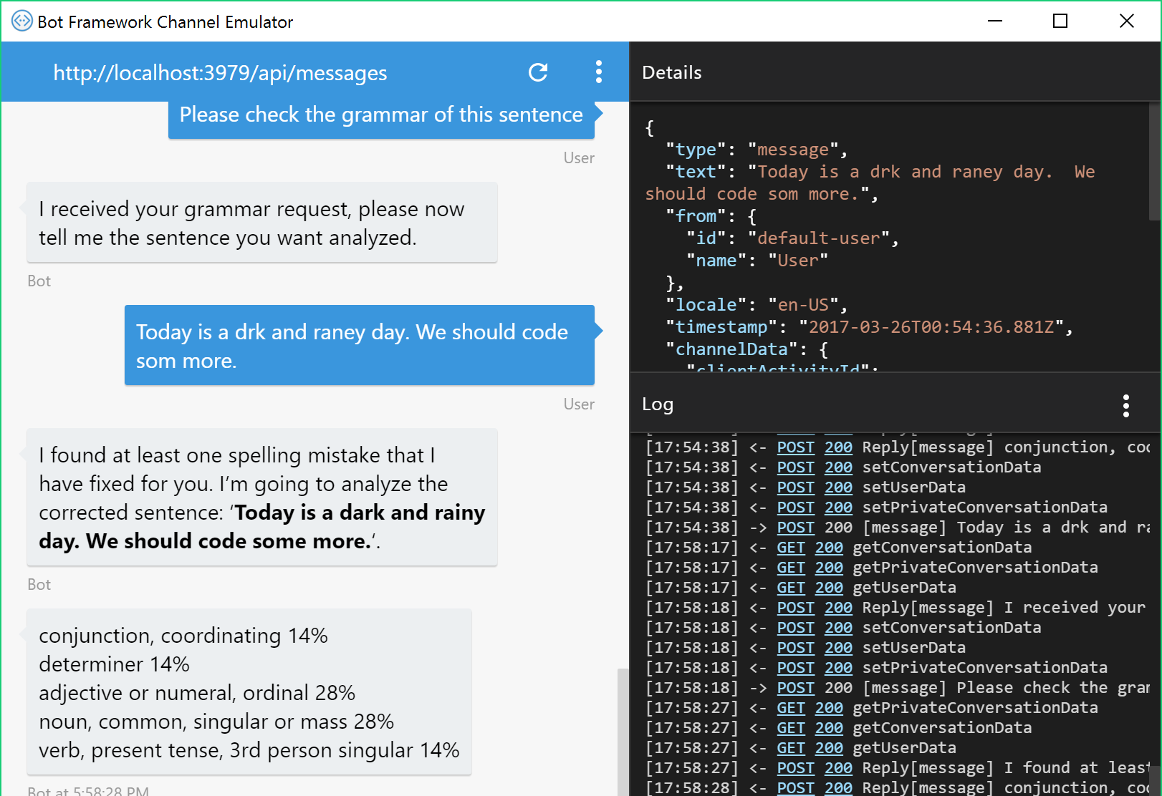
The Tools
Bot Framework SDK for .NET
Bot Framework SDK for node.js
Emulator
Azure (or any website) for hosting
Registration portal
Notes:
Microsoft provides the bot framework to help get started very quickly with bot development.
CLICK – SDK for .NET
Using the Bot Framework SDK for .NET, you can built a bot that runs in the ASP.NET framework. It can run on your machine or be hosted in the cloud.
CLICK – SDK for node.js
Equally there’s an SDK for node.js too, so you can host your bot in either of these frameworks to suit your skillset.
CLICK – Emulator
The Emulator is a tool which connects to your locally or cloud-hosted bot, providing a basic channel in which you can test your bot without it even needing to be registered.
CLICK – Azure hosting
When you are ready to publish your bot, Azure provides a highly available and scalable option for hosting, starting with free tiers. You can host both .NET and node.js bots there.
CLICK – Registration portal
When you’re ready to present your bot to the world, you go to the registration portal where you declare your bot with a unique name and register the cloud-based end-point to which you published your bot. You also decide which channels will be available for users to use the bot.

Slide 21
Demo
A small bot in Node.js
Notes:
Demo 1.2
So let’s see how a basic bot can be created and also how that code looks in node.js

Slide 22
The Cognitive Services
Vision | Speech | Language | Knowledge | Search
Computer Vision Content Moderator Custom Vision Service PREVIEW Emotion API PREVIEW Face API Video Indexer | Speech Service Bing Speech API Custom Speech Service ^{PREVIEW} Speaker Recognition ^{PREVIEW} Translator Speech | Bing Spell Check Language Understanding (LUIS) Linguistic Analysis ^{PREVIEW} Text Analytics Translator Text Web Language Model ^{PREVIEW} | Academic Entity Linking Knowledge Exploration QnA Maker Recommendations | Bing News Search Bing Video Search Bing Web Search Bing Autosuggest Bing Custom Search Bing Entity Search Bing Image Search Bing Visual Search
Notes:
In order for you bot to adeptly handle natural language for users, the entered text needs to be processed to derive some semantic and/or structured elements.
Cognitive Services, with free tiers available for many services, can help bring substance to the bot’s ability to process input.
For example, users may upload images and the Vision APIs may provide information about faces, expressions, emotions, age, etc.
The Speech Recognition APIs may allow uploaded speech to be recognized and used in a conversation.
The Language APIs provide a wealth of services that are great for bot use.
The Knowledge APIs can be used to bring real-world knowledge into structured focus while interacting with a bot.
The Search APIs provide useful assets to return to the user.

Slide 23
LUIS
“Language Understanding Intelligence Service”
For an app, LUIS deals in a number of “Intents” & “Entities”.
Trained with a number of “Utterances” for each intent with Entity placement.
Determines with a degree of confidence which intent was meant from a given phrase.
Provides the Intent and extracted Entities to application.
Developer can see stats on Intents selected by LUIS over time and can guide the training based on actual user utterances.
Notes:
LUIS is typically a key Cognitive Service used with bots.
CLICK – Language Understanding Intelligence Service
LUIS is the Language Understanding Intelligence Service. It lives in the cloud and is usually called by the code you create with the Bot Framework SDK. It gives the bot the ability to determine or discern the intent of the user in provided text.
CLICK – Intents & Entities
LUIS is set up to understand a number of intents that make sense arouhd what bot can do in terms of the user wanting to get information or perform actions. Embedded within a phrase that carries an intent. there cam also be specific parameters or entities (often nounds) that are useful to extract.
CLICK – Intents trained
Intents in LUIS are built by training LUIS with a number of “Utterances”.
CLICK – Determine intent
After training, LUIS can determine with a good degree of confidence which other similar phrases are also conveying the same intent.
CLICK – Intent & Entities provided
The discerned intent is provided to the application along with any entities which have been declared within training utterances.
CLICK – Stats & Manual guiding
You can keep track of which intents have been determined over time. There’s also the option to help guide the system on certain utterances for which the intent is not clear.

Slide 24
Demo
Bot + Cognitive Services
Notes:
Demo 1.3
So let’s see a demo of a bot which uses several Cognitive Services.
The scenario is a proofing tool for business that can be used to check various language aspects of sentences. It could in practice be extended to work on web pages or documents.

Slide 25
Summary
Messaging has become a dominate form of communication.
There a significant cost saving, efficiency and user connection benefits to using bots.
The Bot Framework enables bots to be built in several languages, be hosted in many places and appear in many channels.
Cognitive Services bring significant power to the framework.
Notes:
We’ve seen that messaging is a dominant player in communications for both consumers and business and that businesses are expecting this to increase.
There are clear benefits for many businesses implementing bots
The Bot Framework enables a bot to be built in popular languages and hosted in many places. The bot can operate and appear in many different channels.
Cognitive Services bring significant capabilities to bots and LUIS is a key service for determining the intent of the user.

Slide 26
Resources
Further sessions in this series:
Starting with Conversations as a Platform – The building blocks and services behind the Grammar app
Docs & getting started - https://dev.botframework.com/
Webchat control - https://github.com/Microsoft/BotFramework-WebChat
Learn and try Cognitive Services at - https://www.microsoft.com/cognitive-services
Notes:
As shown

